Slide 1
Leadership III for Fire and EMS: Strategies for Supervisory Success
Situational Leadership

Slide 2
OBJECTIVES
The students will:
Identify two basic leader behaviors.
Identify four leadership styles.
Identify four development levels of followers.
Describe the relationship between development level and leadership style.
Demonstrate diagnostic skills for choosing an appropriate leadership style for a given development level of a follower.
Identify how to provide direction and support to followers and deal with difficulties encountered by followers.

Slide 3
OVERVIEW
Introduction
Flexibility
Diagnosis
Matching Your Leadership Style to the Follower's Development Level
Communication
Summary

Slide 4
Introduction
The importance of leadership.
  Influencing others toward achievement of
  organizational goals.
  Dynamic and effective leadership.
  Dynamic leaders responsive to changing
  needs.
  Effective leaders work at accomplishing
  goals.

Slide 5
Introduction (cont'd)
Leadership style
  The way you supervise
  Autocratic or laissez faire
  "Either/Or" approach
    -- Either task is most important
    -- Or people are most important

Slide 6
Introduction (cont'd)
Either/Or approach simply doesn't work.
No one style is always appropriate.
  Task needs more attention.
  Person and task require equal attention.
  Person needs more attention.
  Neither require much attention.

Slide 7
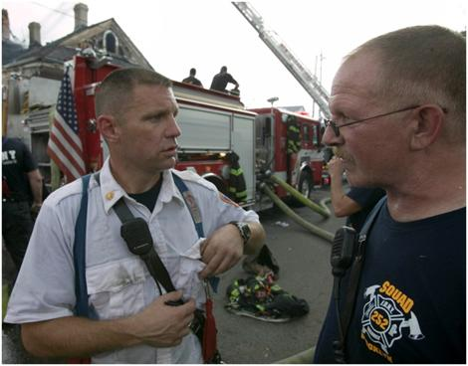
Introduction (cont'd)
Situational leadership requires three basic skills:
  Flexibility: ability to
  change leadership style
  Diagnosis: ability to
  accurately assess needs
  Communication:
  ability to reach mutual
  understanding

Slide 8
Flexibility
Four basic styles:
  Directing (S-1)
  -- Specific instructions; close supervision
  Coaching (S-2)
  -- Close supervision; explains and praises
  Supporting (S-3)
  -- Facilitates and supports; shares responsibility
  Delegating (S-4)
  -- Responsibility turned over to follower

Slide 9
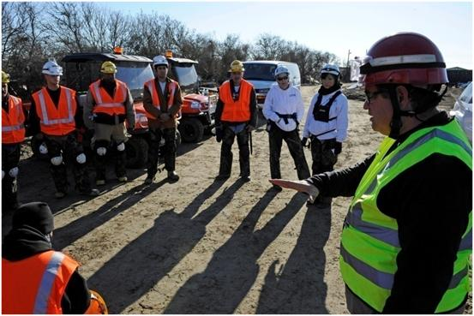
Flexibility (cont'd)
Two types of leader behavior:
  Direct
  Supportive

Slide 10
Flexibility (cont'd)
Direct behavior:
One-way communication; telling the follower:
  What to do
  When to do it
  Where to do it
  How to do it
Close supervision
Lots of feedback on performance
Keywords: structure, control, supervise

Slide 11
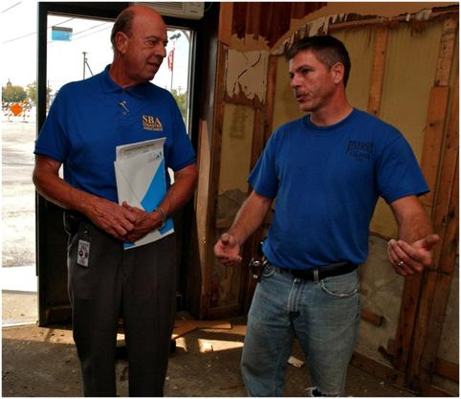
Flexibility (cont'd)
Supportive behavior:
  Two-way communication
  Listening
  Explaining decisions
  Providing support,
  encouragement, praise
  Facilitating involvement in
  Decisionmaking
  Keywords: listen, praise, facilitate

Slide 12
Flexibility (cont'd)
The four leadership styles combine directive and supportive behaviors in varying degrees.

Slide 13
Directing (S-1)
High direction/Low support.
Primarily one-way communication.
Task gets more attention than person.
Leader directs follower.
Leader supervises closely.
Leader gives regular feedback.
Follower has no involvement in decisionmaking or problem-solving.

Slide 14
(High)
SUPPORTIVE BEHAVIOR
S-1
DIRECTING
High Direction
Low Support
(Low)
DIRECTIVE BEHAVIOR
(High)

Slide 15
Coaching (S-2)
High direction/High support.
Task and person receive equal attention.
Leader provides specific direction, close supervision, immediate feedback.
Leader is also supportive.
Leader begins to open two-way communication.

Slide 16
(High)
COACHING
High Direction
High Support
S-2
SUPPORTIVE BEHAVIOR
S-1
DIRECTING
High Direction
Low Support
(Low)
DIRECTIVE BEHAVIOR
(High)

Slide 17
Supporting (S-3)
Low direction/High support.
Person receives more attention than task.
Minimal direction, supervision, feedback.
Support, encouragement, praise.
Two-way communication.
Leader and follower share responsibility.
Leader facilitates follower growth.

Slide 18
(High)
SUPPORTING
Low Direction
High Support
COACHING
High Direction
High Support
S-3
S-2
SUPPORTIVE BEHAVIOR
S-1
DIRECTING
High Direction
Low Support
(Low)
DIRECTIVE BEHAVIOR
(High)

Slide 19
Delegating (S-4)
Low direction/Low support.
Neither task nor person receives close attention.
Leader turns over responsibility to follower.
Communication is limited, but two-way.
Direction is limited.

Slide 20
(High)
SUPPORTING
Low Direction
High Support
COACHING
High Direction
High Support
S-3
S-2
SUPPORTIVE BEHAVIOR
S-4
S-1
DELEGATING
Low Direction
Low Support
DIRECTING
High Direction
Low Support
(Low)
DIRECTIVE BEHAVIOR
(High)

Slide 21
Summary of Leadership Styles
Styles differ in terms of:
  Amount of directive behavior
  Amount of supportive behavior
Leader:
  Sets goals
  Observes performance
  Provides feedback
  Remains accountable for achievement

Slide 22
Summary of Leadership Styles (cont'd)
Difference lies in the degree to which the leader engages in these behaviors.
Cautions:
  S-1 is directing not dictating.
  S-2 is coaching not smothering.
  S-3 is supporting not rescuing.
  S-4 is delegating not abdicating.
No single best style; each is appropriate at some time.
Best leader can use each style as needed.

Slide 23
FOUR STYLES OF LEADERSHIP
Supporting
not
Rescuing
Coaching
not
Smothering
S-3
S-2
Delegating
not
Abdicating
Directing
not
Dictating
S-4
S-1

Slide 24
Diagnosis
Predict followers performance by considering:
  Past performance.
  Self-confidence and enthusiasm.
Development determines most appropriate leadership style.

Slide 25
Diagnosis (cont'd)
Development level--measure of degree of competence and level of commitment
  Competence--function of knowledge
  and skills
  Commitment--function of confidence
  and motivation

Slide 26
Diagnosis (cont'd)
Four basic development levels:
  Development level D-1 = Low competence/High
  commitment
  Development level D-2 = Some competence/Low
  commitment
  Development level D-3 = High competence/ Variable commitment
  Development level D-4 = High competence/High
  commitment

Slide 27
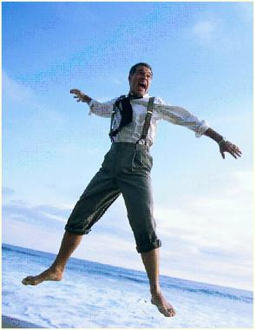
D-1: The Enthusiastic Beginner
Low competence--lack of knowledge/ skills.
High commitment--excitement about new task and/or confidence.
False confidence--Examples:
  New recruit.
  Veteran with new task.
  Followers doing something they have
  never done before.

Slide 28
D-2: The Disillusioned Learner
Some competence--task proficiency increased but individual hasn't mastered knowledge and skills.
Low commitment--decrease in self-confidence and/or motivation.
As skills develop, individual realizes involvement.
"The more I know, the more I realize I don't know".
Examples:
  Driving pumper instead of car.
  Cardiopulmonary resuscitation (CPR) on real person versus dummy.
  Veteran learning new computer program.

Slide 29
D-3: The Reluctant Contributor
High competence--individual has mastered required knowledge and skills.
Variable commitment--lacks self-confidence and/or motivation.
Examples:
  Veteran does the same task for a long time and loses
  interest.
  Proficient follower has personal priorities that
  conflict with company responsibilities.
  Proficient follower still lacks self-confidence.

Slide 30
D-4: The Peak Performer
High competence--individual has mastered task.
High commitment--a lot of self-confidence and high interest in performing WELL without supervision.
Willing to take on additional responsibility.
Examples:
  Anyone who has demonstrated task proficiency and
  ability to work well without close supervision.
  Self-starter who always demonstrates initiative and
  ability to handle responsibility.

Slide 31
(High)
THE FOUR LEADERSHIP STYLES
SUPPORTING
Low Direction
High Support
COACHING
High Direction
High Support
SUPPORTIVE BEHAVIOR
S-3
S-2
S-4
S-1
DELEGATING
Low Direction
Low Support
DIRECTING
High Direction
Low Support
(Low)
DIRECTIVE BEHAVIOR
(High)
HIGH MODERATE LOW
D-4 D-3 D-2 D-1
DEVELOPED
DEVELOPING
DEVELOPMENT LEVEL OF FOLLOWER(S)

Slide 32
Matching Your Leadership Style TO THE FOLLOWER'S DEVELOPMENT LEVEL
Directing (S-1) most appropriate for those who:
  Lack competence
  Need direction and supervision
Coaching (S-2) most appropriate for those who:
  Have some competence but…
  Still need direction and supervision
  Need positive reinforcement
  Need some involvement

Slide 33
Matching Your Leadership Style TO THE FOLLOWER'S DEVELOPMENT LEVEL (cont'd)
Supporting (S-3) most appropriate for those who:
  Mastered required knowledge and skills
  Lack self-confidence and need support
  Lack motivation and need opportunity for greater
  involvement in decisionmaking
Delegating (S-4) most appropriate for those who:
  Perform well without supervision
  Have confidence in own ability
  Are highly motivated

Slide 34
Matching Your Leadership Style to the follower's development level (cont'd)
Key concepts:
  Development level of an individual must be assessed
  with specific task in mind
  Development level varies from task to task
  Decline in performance--move to previous style

Slide 35
Activity SL.1
Analyzing Leadership Styles

Slide 36
Activity SL.2
Developing Diagnostic Skills

Slide 37
Communication
"Situational Leadership is not something you do to people, it's something you do with people!" (Blanchard)
  Important follower understands style
  choice.
  Otherwise, follower may resent being
  treated differently from peers.

Slide 38
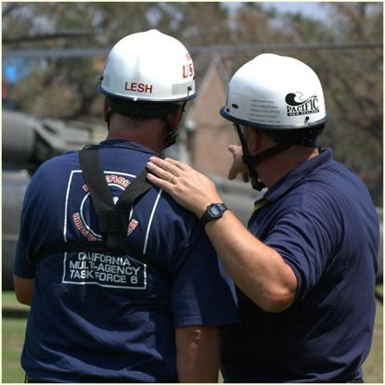
Communication (cont'd)
Share your knowledge of situational leadership with each follower:
  Nothing negative
  about D-1 or D-2
  Purpose of assessment
  is to help person perform
  at peak potential

Slide 39
Communication (cont'd)
Make sure task assignments are smart
  S--Specific
  M--Measurable
  A--Attainable
  R--Relevant (appropriate)
  T--Trackable

Slide 40
Communication (cont'd)
Agreement on development level and leadership style:
  Communicate direction and
  support
  Remain flexible

Slide 41
Communication (cont'd)
If difficulties arise, identify the problem area(s):
  Competence problem?
  Commitment problem?
    -- Related to self-confidence?
    -- Related to motivation?

Slide 42
Communication (cont'd)
For competence problems, provide:
  Training
  Proper orientation to the task
  More observation of performance
  Specific feedback on outcomes and/or
  expectations

Slide 43
Communication (cont'd)
For motivation problems, provide:
  Positive reinforcement of desired
  behavior
  Supportive listening
  Better rewards for acceptable
  performance
  More serious consequences for negative
  performance

Slide 44
Communication (cont'd)
For confidence problems, provide:
  Reassurance and support for successes
  Encouragement
  Positive feedback for improvement

Slide 45
Summary
Clear definition of task
Diagnose development level
Match development level with leadership style
Deliver style with balance
Evaluate effectiveness

Slide 46
Remember…
"Everyone has peak performance potential. You just need to know where they're coming from and meet them there." (Blanchard)

